Slide 1

Islington CCG update
Locality Patient Participation Groups
March 2014

Slide 2

Structure of the session
CCG overview
Finance

Slide 3
How our Governing Body is made up
Elected members
Executive members
Appointed
members
Observers
GP Members
Practice Nurse
Chief Officer
Chief Finance Officer
Lead Nurse
Lay Members
Secondary Care Doctor
Patient Representative
Council
Healthwatch
Local Medical Committee

Slide 4

Executive Directorate
Chair
Dr Gillian Greenhough
Service Director
Adult Social Care
(Local Authority)
Simon Galczynski
Director
Public Health
(Local Authority)
Julie Billett
Chief Officer
Alison Blair
Joint Primary
Care Clinical
Lead
(C&I CCG)
Vacant
Commissioning
Support Director
(CSU C&I CCG)
Tony Hoolaghan
PA
Alice Mutumba
(CSU)
Chief
Finance Officer
Ahmet Koray
Director of Quality
& Integrated
Governance
Martin Machray
Director of
Commissioning
Paul Sinden

Slide 5
Governing Body Members
ELECTED
EXECUTIVE
Sharon Bennett
GP
Katie Coleman
Co-Vice Chair GP
Gillian Greenhough
Chair and GP
Jennie Hurley
Practice Nurse
Sabin Khan
Salaried GP
Rathini Ratnavel
GP
Stephen Rogers
GP
Jo Sauvage
Co-Vice Chair and GP
Karen Sennett
GP
Deborah Snook
Practice Manager
Alison Blair
Chief Officer
Ahmet Koray
Chief Finance Officer
Martin Machray
Director - Quality & Integrated Governance and Head Nurse
OBSERVERS
Julie Billett
Director of Public Health LBI
Robbie Bunt
Local Medical Committee
Simon Galczynski
LBI Adult Social Services
Phillip Watson
Healthwatch Islington
APPOINTED
Mo Akmal
Secondary Care Clinician
Sorrel Brookes
Lay Member
Anne Weyman
Vice Chair and Lay Member

Slide 6
Our 10 business objectives to support our four priorities
Quality
Ensure commissioning systems and processes in place to support quality improvement and ensure high performing safe services and innovative models of care
Ensure the views and interests of patients and the community are central to decision-making
Ensure appropriate leadership, systems and processes for children and adult safeguarding
Secure improvement in quality and develop capacity and capability in primary care
Organisational Development
Continue to develop the CCG to be the best it can be (governing body, staff team and members)
Ensure better data and contracting delivers improved outcomes and effective system-wide working
System
Delivering the Operating Plan
Work effectively with the Health and Well Being Board, partners and providers in the health and social care system, in Islington, in North and East London and nationally
Ensure our providers of healthcare are fit for purpose for the future. In particular, work with the Whittington ICO to deliver the programme of transformational change and longer term viability
Deliver operating plan including performance improvement, savings and investments
Meet financial requirements including balance

Slide 7
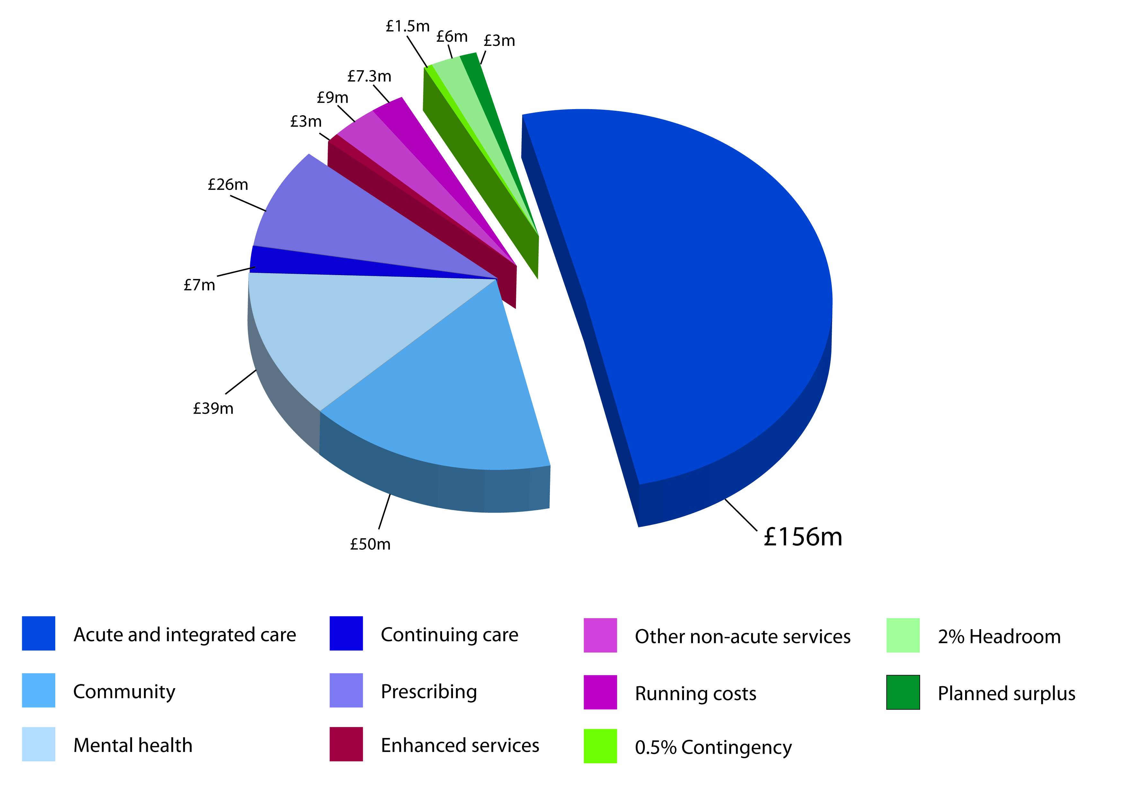
Our finances
How the CCG spends it funding

Slide 8
How the CCG spends its funding
CCG main contracts (nearly 60% of CCG allocation):
Whittington Health £88m
Integrated Care Organisation – hospital and community services
UCLH £56m
Hospital services
Specialist (tertiary) services commissioned by NHS England
Camden & Islington Foundation Trust £34m
Mental health services – community and inpatient

Slide 9
Whittington Health
CCG has invested in trust services in the last 2 years:
Block contract (standard payment not varying with activity levels) plus investment
CCG recurrent investment £2m in last 2 years:
Children’s services – specialist nurses; speech and language therapy; practice nurses, CAMHs
Adult services – community geriatrician; community equipment; diabetes consultant; audiology
Ambulatory Care – alternative to admission
CCG non-recurrent investment £1.7m in last 2years:
Short-term funding to improve quality and processes – theatre utilisation; enhanced recovery
Winter pressures – additional capacity to cope with additional demand
Quality standards – Institute for Healthcare Improvement; pressure sores; theatre utilisation
Qualitative focus with the trust:
Quality of community services – podiatry; physiotherapy; district nursing
Waiting times for surgery
Enhanced recovery
Locality structure – linking into general practices

Slide 10
University College London Hospital (UCLH)
CCG has invested in trust services through payment by results:
Payment flexed according to activity levels - £4m extra in 2013/14
CCG investment
Activity levels (see above)
Readmissions prevention
Winter pressures - additional capacity to cope with additional demand. Trust is developing a business case to expand A&E and Urgent Care Centre
Qualitative focus with the trust:
Alternatives to admission – developing ambulatory care pathways
Reducing waiting times for surgery
Payment by Results – ensure only pay for validated and appropriate activity

Slide 11
Camden & Islington Foundation Trust
CCG has invested in trust services in the last 2 years:
Block contract (standard payment not varying with activity levels) plus investment
CCG recurrent investment £2m in last 2 years:
Dementia – memory clinic; carers; last years of life care
Adult services – rehab and recovery; personality disorders; neuro-development disorders
CCG non-recurrent investment £1m in last 2years:
Short-term funding to improve quality and processes – Stacey Street
Winter pressures – mental health liaison with hospital services including A&E
Qualitative focus with the trust:
Reducing waiting times for assessment and access to psychological therapies
Introduction of mental health tariffs – move to transparent care packages and outcome measures. Also moves from block contract to payment varying with activity
Locality structure – linking into general practices
Crisis services – less out-of-borough placements

Slide 12
Commissioning for Quality & Safety
A Framework for all providers
Commissioning for Quality & Innovation (CQUIN) - 2.5% of contract baseline – prevention; integrated care; friends and family test; value based commissioning.
Quality Premium - £5 per head of population - £1m for Islington CCG
National measures – reducing avoidable admissions; reducing early mortality
Local measures – smoking cessation; reablement; support for people with long-term conditions
Scaled for delivery of Constitution – waiting times – cancer, surgery, A&E
Provider contracts - metrics and performance indicators
Delivery of Constitution and Outcomes Framework – waiting times
Incentives and penalties –single sex breaches; C-Difficile; A&E; Information
Best practice tariffs – premium paid for enhanced delivery
Provider Quality Accounts – summary of the above
Introduction of Value Based Commissioning – pay for outcomes not outputs
Francis Report recommendations
Triangulation on service quality through patient & GP feedback

Slide 13
Questions

